Slide 1
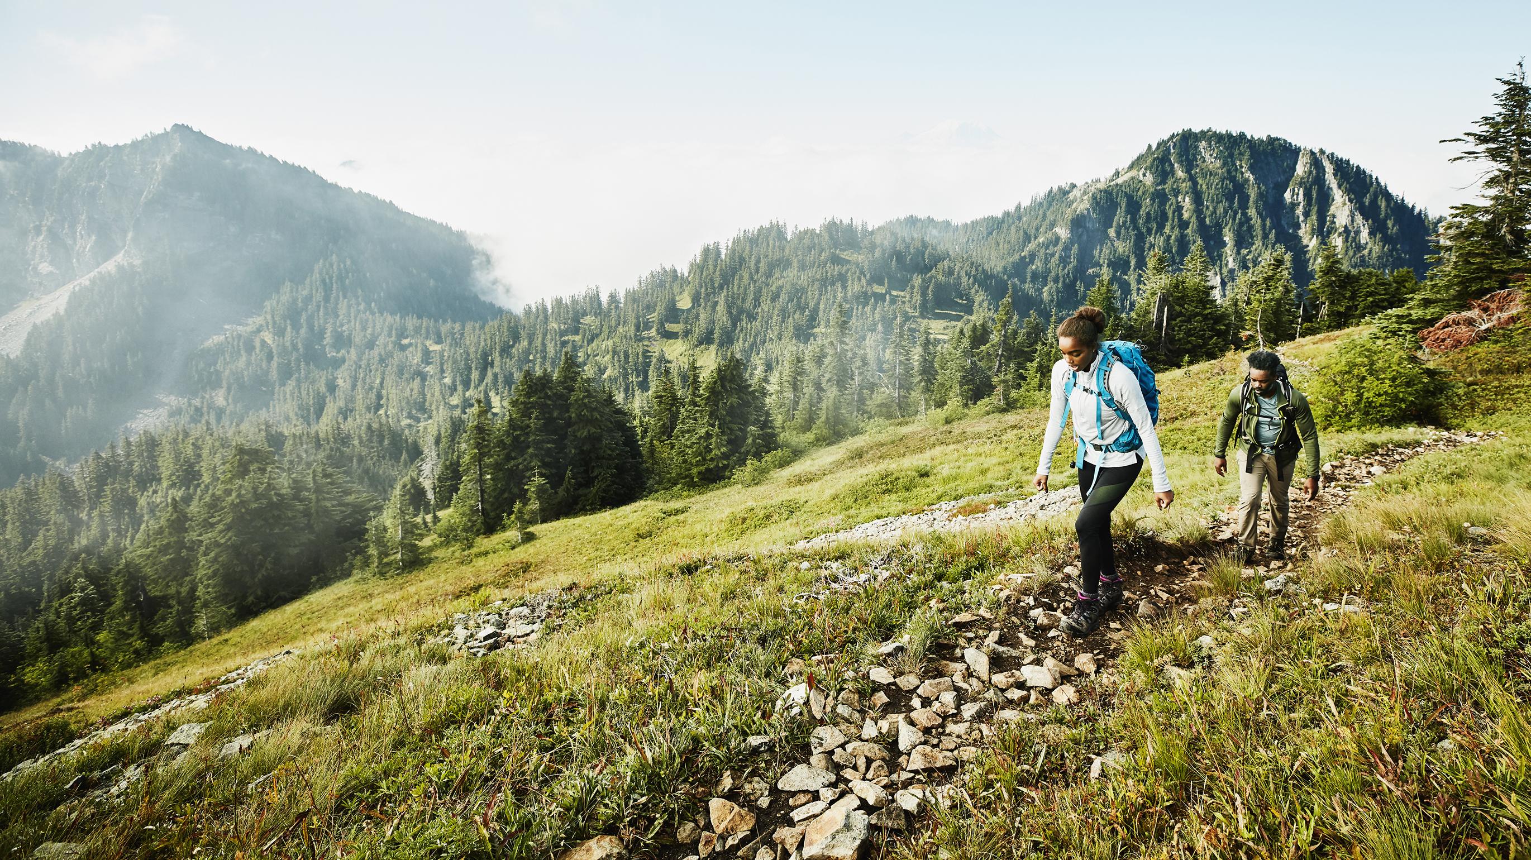
Outland Adventures
Team Silver:
Tyson B. - Crystal L. - Rashai R.

Slide 2
Introduction!
Hello CSD-310,
We are Team Silver, and our members are Tyson, Crystal, & Rashai. We are excited to share our findings and ideas from our Case Study on Outland Adventures.

Slide 3

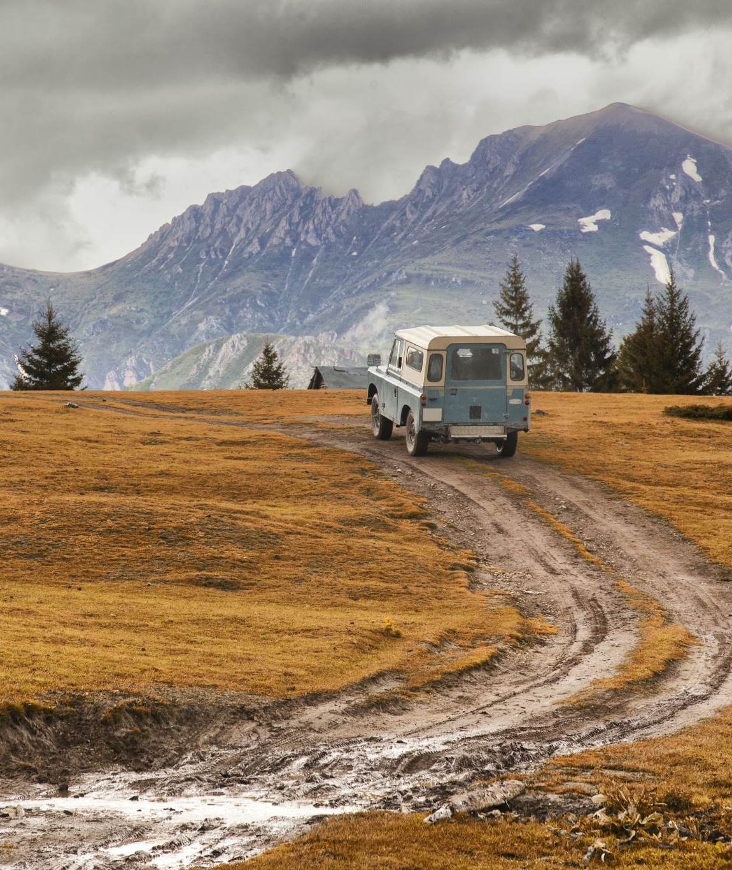
Case Study brief
Hello CSD-310,
Our project is about a travel company known as Outland Adventures. Outland Adventures was started by Blythe Timmerson and Jim Ford. It was originally their hobby, but it became successful enough to turn it into something more. They now have 5 employees.
Blythe and Jim want to optimize the company, so they have a few questions, like:
Should we keep selling equipment?
Which location is least booked?
How old is our inventory?

Slide 4
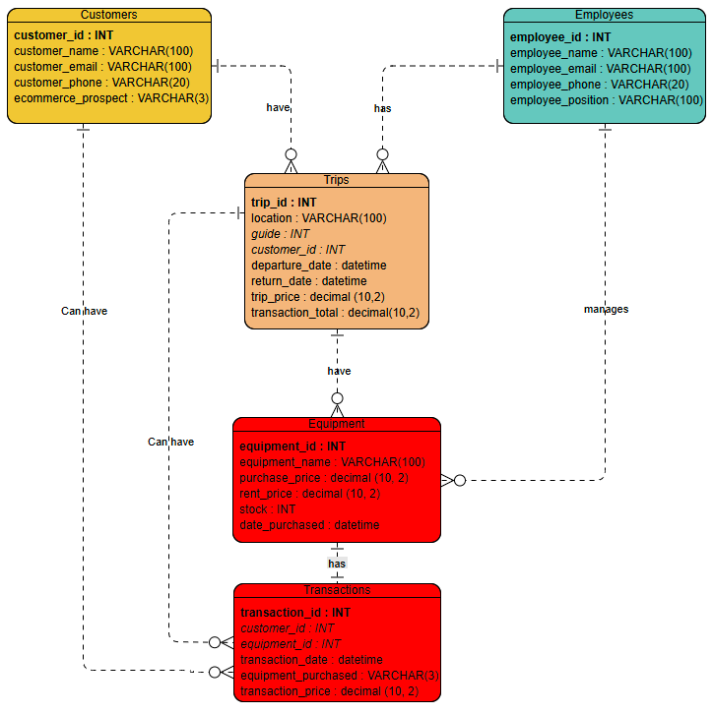
ERD

Slide 5
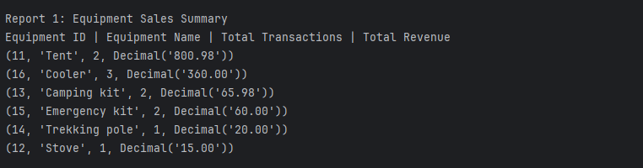
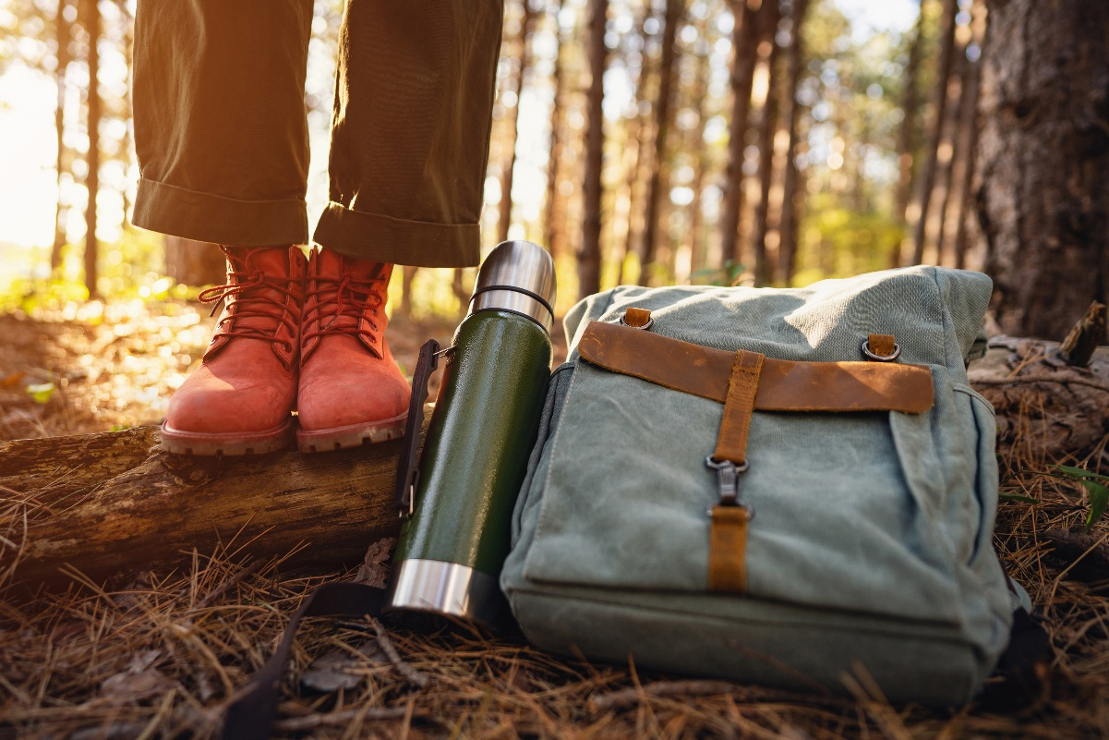
Report 1
Our first report shows equipment sales.
We wanted to see if our customers benefit from us keeping equipment on hand for sale. While we also do rent out our equipment for those who do not want the hassle of their own.
These are our sales so far this year.

Slide 6

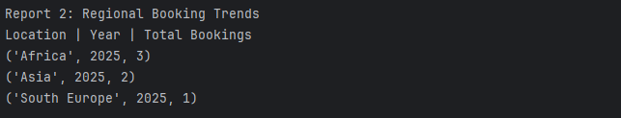
Report 2
Our second report is for our booking trends.
We wanted to see which locations our customers favor the most and which they favor the least. This would be beneficial so we could add more tours or guides for the ones that are more sought after than the others.
As you can see, South Europe is the least favorite travel location of our customer so far this year.

Slide 7
Report 3
Our third report shows equipment age.
Safety is key, and we wanted to know what equipment items might need replacing soon. We want our travel customers to feel safe and be able to trust that we have their safety and best interests at heart when it comes to enjoying their trips, as well comfort of the necessary equipment for these trips.
Only one category in our items is still here five years after our purchase date. It's important to note that we rent items as well, so these may only be rentals and not equipment for sale. Once these equipment items get to a point where their safety may be compromised even a little bit, we will rotate them out for new ones.

Slide 8
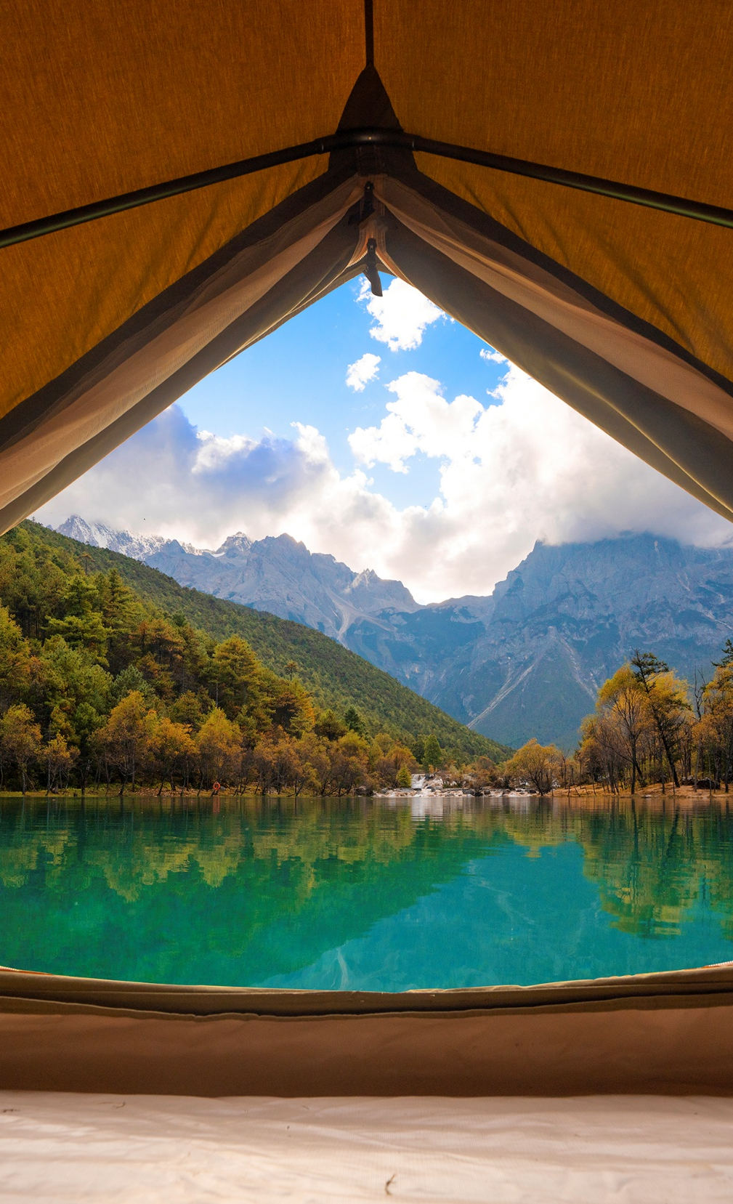
Assumptions
Something to track booking
Each product will need its own id for the program
Employees can only manage order entry but not suppliers or inventory updates
Equipment can either be sold or rented to customers.
A customer can purchase or rent multiple equipment items.
Equipment has a purchase date and allows age tracking.
Each piece of equipment has a stock quantity.

Slide 9
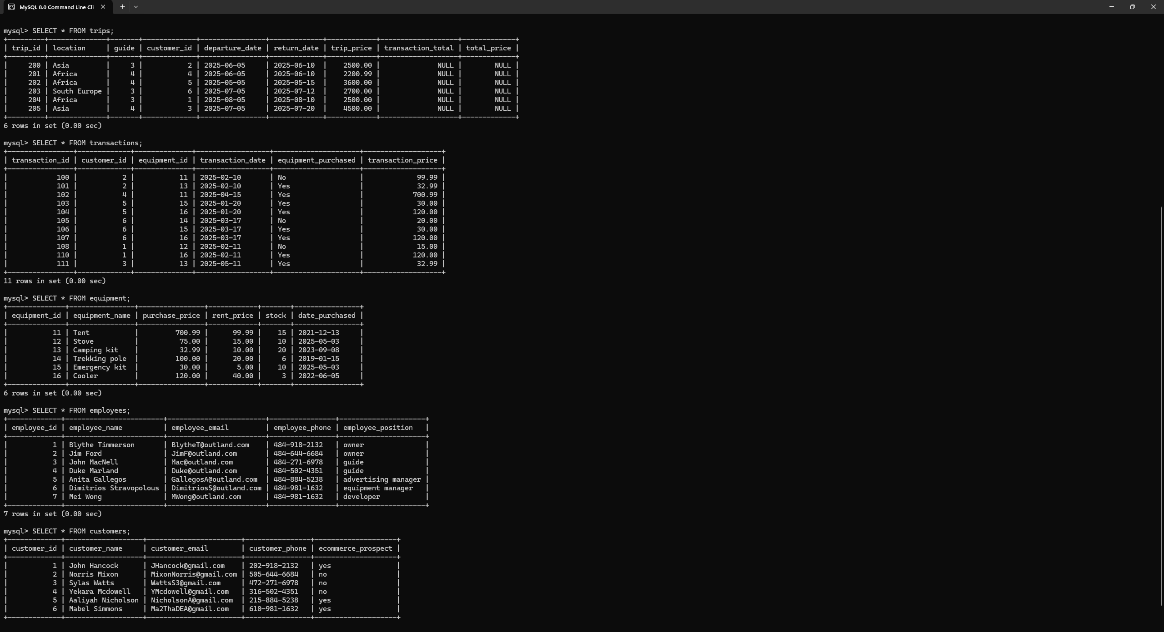
SQL Query

Slide 10
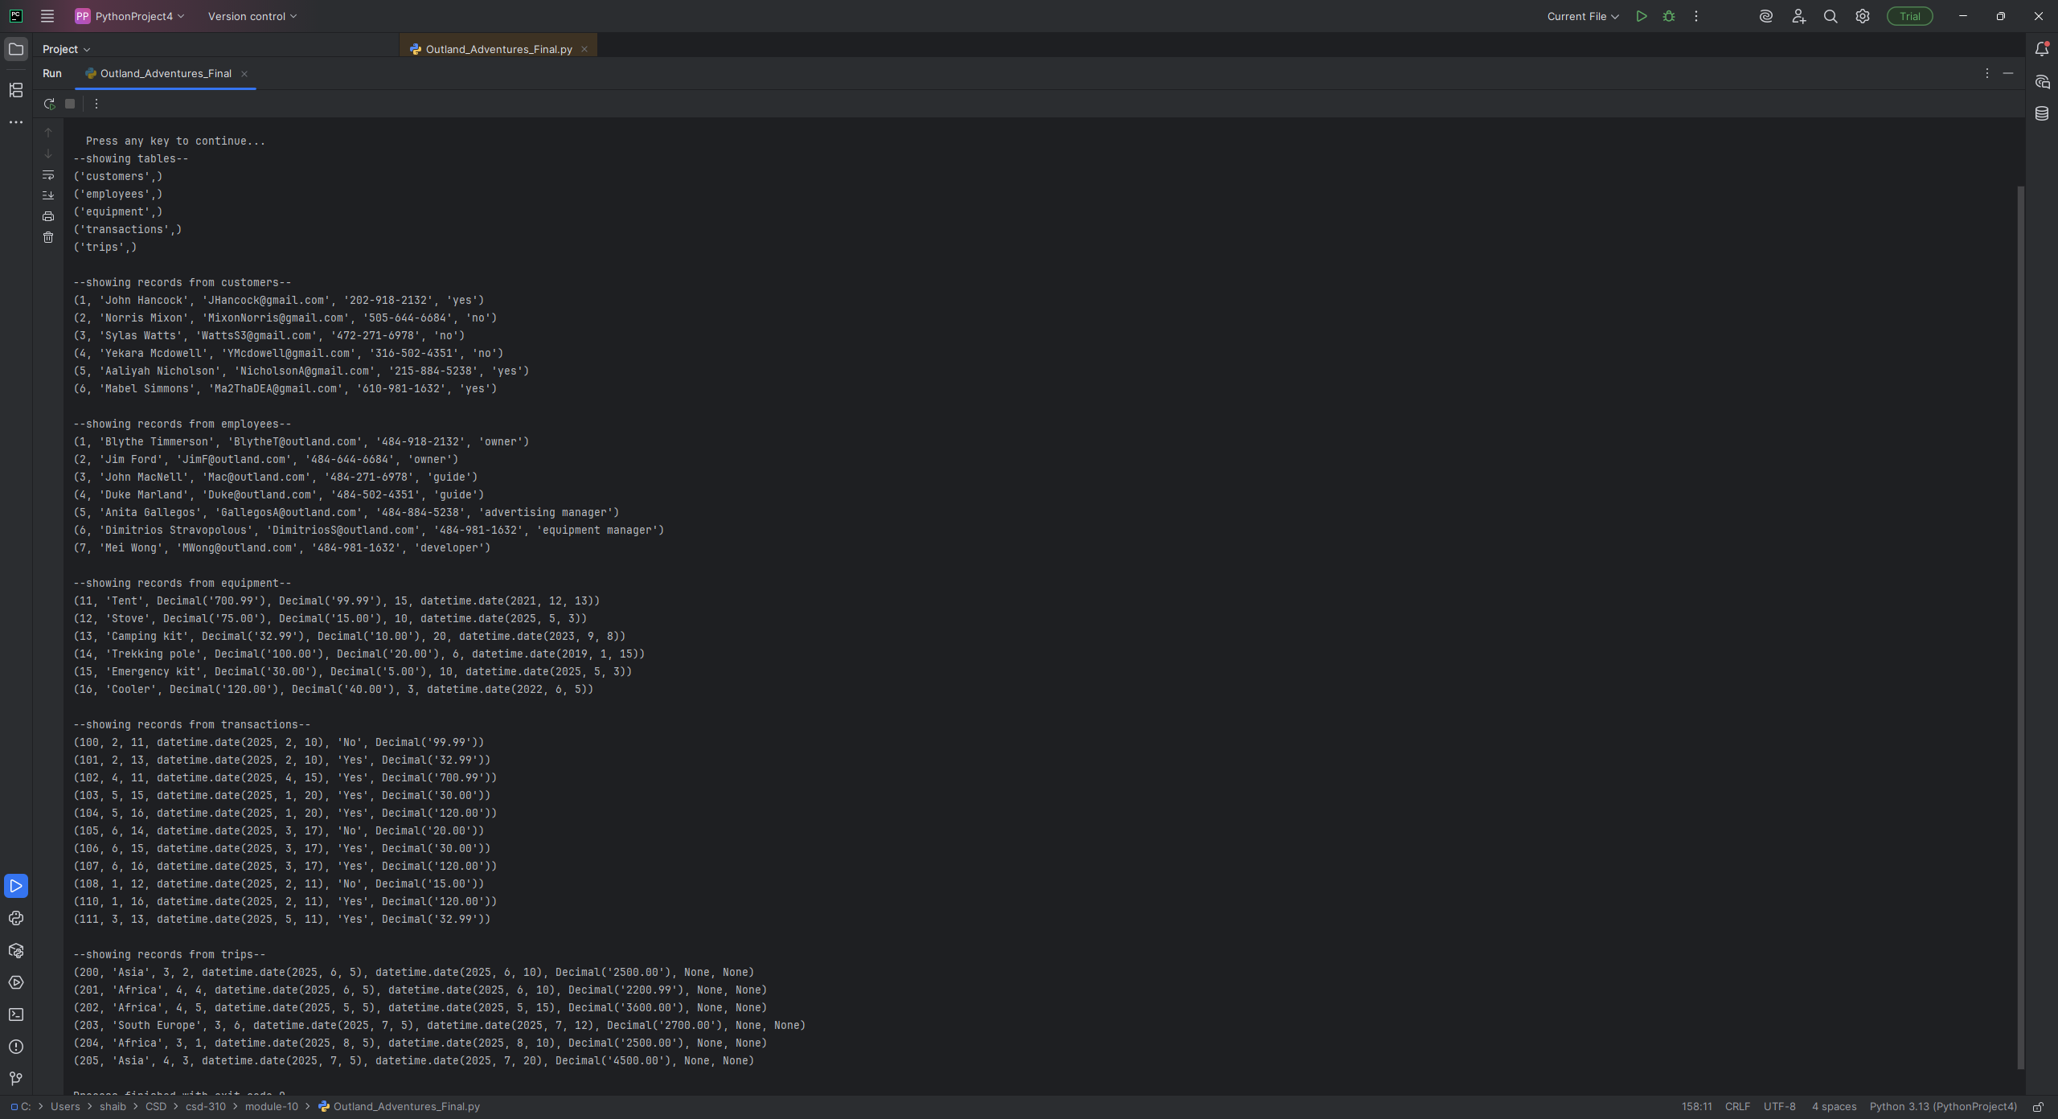
Python results

Slide 11

Don’t be caught wildly unprepared. Let us help you into your dream adventure!

